Slide 1

Hacking & Defending: A Student's Guide to Cybersecurity Tools
Explaining the Technology We Used in Our Project
Presented by: Mohammed Amar, Nooraddin Ismail, Mohammed Abdualwaheed, Anas Adel

Slide 2





The Two Sides of Cybersecurity
Imagine a castle. There are people trying to protect it, and people trying to get in. In cybersecurity, it's the same!
The Blue Team (Defense)
The Red Team (Attack)
Their job is to protect the computer systems. They are the "Guards" of the castle, building strong walls and monitoring for threats.
Their job is to test the defenses by trying to break in. They think like the "Attackers," looking for weak points.
In our project, we played both roles to learn the full spectrum of cybersecurity.
Defense
Counter
Strike
Attack

Slide 3

Nmap: Finding the Doors
Nmap (Network Mapper) is a free tool that scans a network, like a detective walking around a building checking which doors and windows are open.
It finds which computers are on the network and which services (ports) are open on those computers.
How We Used It:
The Attack Team used Nmap to scan the Defense Team's network, revealing a target system (Metasploitable 2) with many open vulnerabilities.

Slide 4
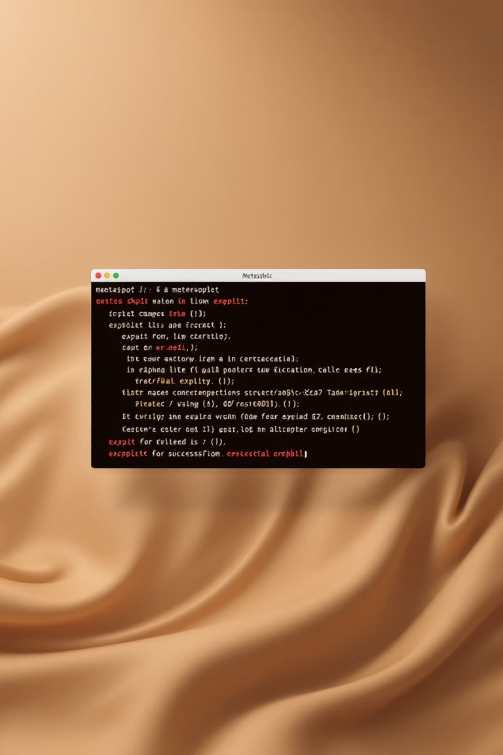
Metasploit: Opening the Doors
Metasploit is a powerful tool containing "exploits" – pieces of code that use a weakness to get inside a system.
Once Nmap finds an open door (a vulnerability), Metasploit provides the key to open it, testing if the weakness can actually be used to break in.
How We Used It:
After Nmap identified a vulnerability, we used Metasploit to find the right exploit.
Successfully launching the exploit gave us control ("getting a shell") of the target computer.

Slide 5
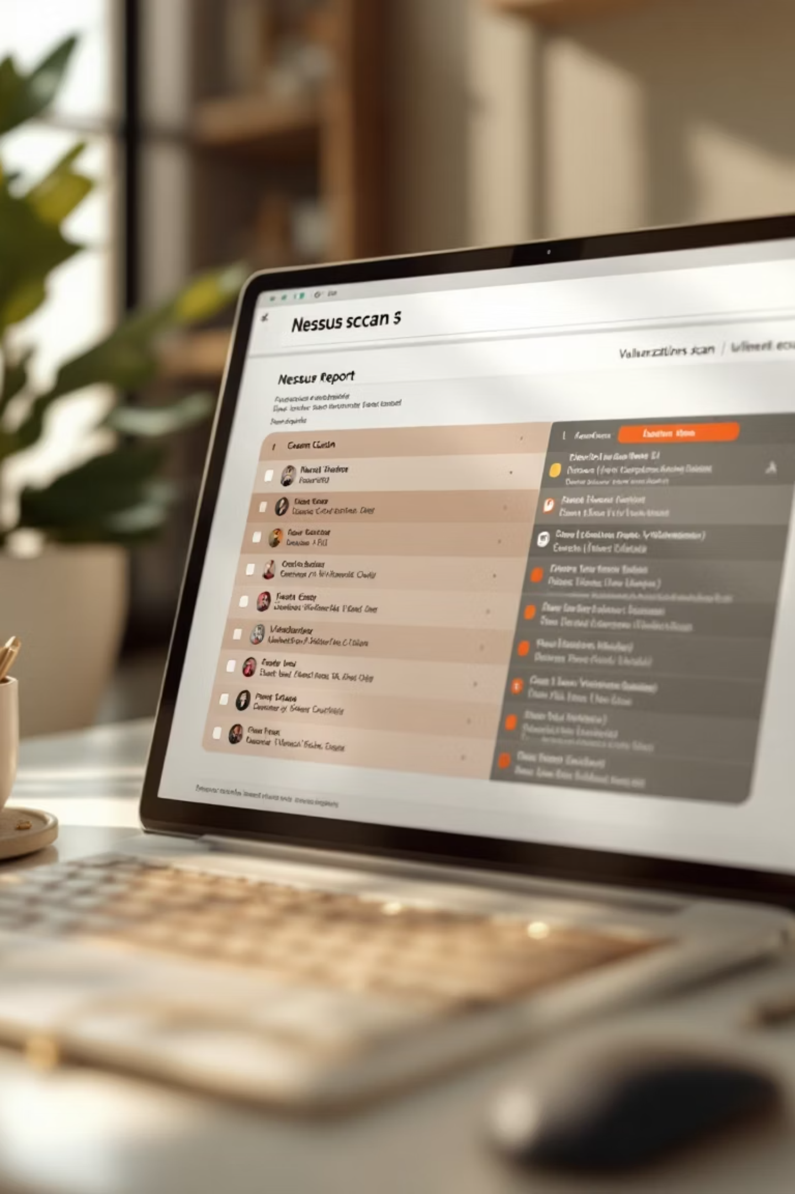
Nessus/OpenVAS: Checking for Weaknesses
These are "vulnerability scanners" that check a computer system for thousands of known problems.
It's like hiring an inspector for your house to find bad locks or weak walls, so you can fix them before a robber does.
How We Used It:
Our Defense Team ran scans on our network to generate a report of all our weak spots.
This helped us understand what an attacker would see, enabling proactive defense.

Slide 6

Snort: The Alarm System
Snort is an Intrusion Detection System (IDS) that watches network traffic, acting like a security guard or an alarm system.
It has "rules" that describe what an attack looks like. If traffic matches a rule, it creates an alert.
How We Used It:
While the Attack Team used Nmap and Metasploit, Snort was running on the Defense network.
Snort successfully detected the attack traffic and generated alerts, proving our alarm system worked as intended.

Slide 7

OpenCTI: The Threat Library
OpenCTI is a platform to organize information about cyber threats and attackers, acting as a library for defenders.
It stores data on known attackers, their tools, and attack methods, helping the Blue Team prepare defenses.
How We Used It:
We set up OpenCTI to begin building our own library of threat information.
This strategic approach helped us understand potential adversaries and enhance our defensive posture.

Slide 8

Elasticsearch & Kibana: The Security Dashboard
Elasticsearch stores huge amounts of data (like computer logs), while Kibana creates graphs and charts from it.
How We Used It:
Our goal was to send all logs to Elasticsearch and visualize activity in Kibana.
Together, they form a SIEM (Security Information and Event Management) system.
Setting up security certificates for this system was a significant, rewarding challenge.
It's like a central security control room, displaying all alerts and logs on one dashboard for a complete overview.

Slide 9
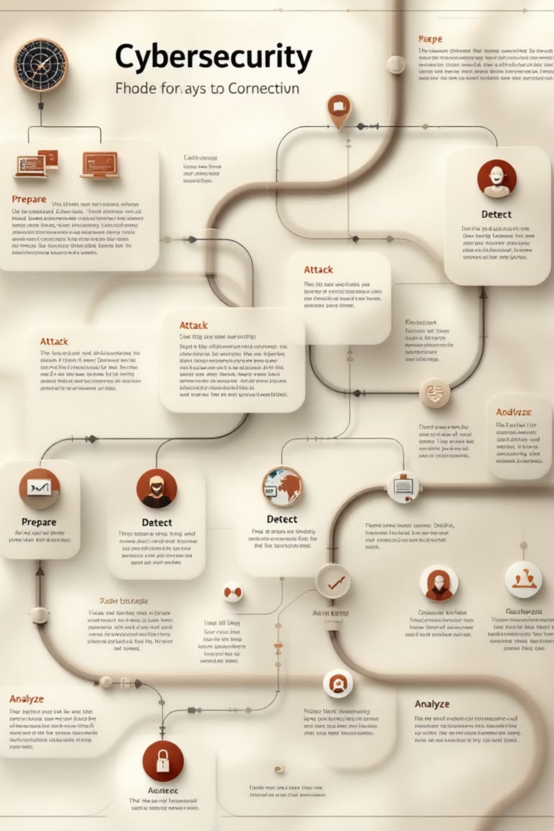
The Full Attack & Defense Cycle
This is how all the tools can work together:
1
Prepare (Blue Team)
Use Nessus to find your own weaknesses and OpenCTI to study potential attackers.
2
Attack (Red Team)
Use Nmap to find a target and Metasploit to break in.
3
Detect & Analyze (Blue Team)
Snort sees the attack and sends an alert. All logs and alerts go to Elasticsearch. Kibana provides a full story on one dashboard.

Slide 10

Malcolm: Visibility & Remediation
What is Malcolm?
Malcolm is a powerful network monitoring and security analysis tool. It gives you full visibility into your network activity, helping you quickly identify and address security issues.
How to Use Malcolm
1
Threat Detection
2
Reporting & Dashboards
3
Efficient Investigation
4
Effective Remediation
Learn More

Slide 11
Why This Matters
These tools are not just academic exercises; they are used by real cybersecurity professionals every day.
Understanding how attackers work (Red Team) is the best way to learn how to defend (Blue Team).
Practice is the most important thing in cybersecurity!
Any Questions?

